Slide 1

NYC INVESTMENT ANALYSIS
Xinran Tao
02/05/2019
Notes:
Hello everyone, welcome to the project presentation! The idea is to

Slide 2
Content
Business Context
Data Preparation & Quality Check
Model Methodology
Model Results & Insights
Further Analysis
Notes:
There are five sections in this project presentation.

Slide 3
Business Context
Notes:
Now let’s start with the business context. I will give you a background of this project in case you are not familiar with it.

Slide 4
Business Context
Background
Our client is a real estate company, they have a niche in purchasing properties to rent out short-term as part of their business model specifically within New York City. The real estate company has already concluded that two-bedroom properties are the most profitable; however, they do not know which zip codes are the best to invest in.
The real estate company has engaged our firm to build out a data product and provide conclusions to help them understand which zip codes would generate the most profit on short term rentals within New York City.
Objective
Find out the most profitable zip code for short-term investment in NYC.
Notes:
Our client is a real estate company, they have a niche in purchasing properties to rent out short-term as part of their business model specifically within New York City. The objective is to find out the most profitable zip code for short-term investment in NYC.

Slide 5
Data Preparation & Quality Check
Notes:
Before we build the model, It’s important to prepare our data and have a data quality check so that we are able to better understand our data and get the right data for our analysis.

Slide 6



Data Overview
Airbnb Dataset — Revenue Data
AirBnB provides information on the listings with 97 features including location (City, State, Zipcode), property features (Bedrooms, Room Types) and the rent price (Daily Price, Weekly Price, Monthly Price) to lease out their property. The date on rent is in 2017-05.
Zillow Dataset — Cost Data
Zillow provides information of the location (Zipcode, City) and the historical median property price within that area in different years (Each month’s price is a column). The time range is from 1996-04 ~ 2017-06.
Notes:
(略说，先提一下存在的问题)Firstly, let’s take a look at our dataset. The Airbnb dataset provides the revenue’s data. It has 97 variables describing locations, property features and rent price ofthe listings in May 2017. The Zillow dataset provides the cost data, it describes locations and property price data from April 1996 to June 2017.

Slide 7
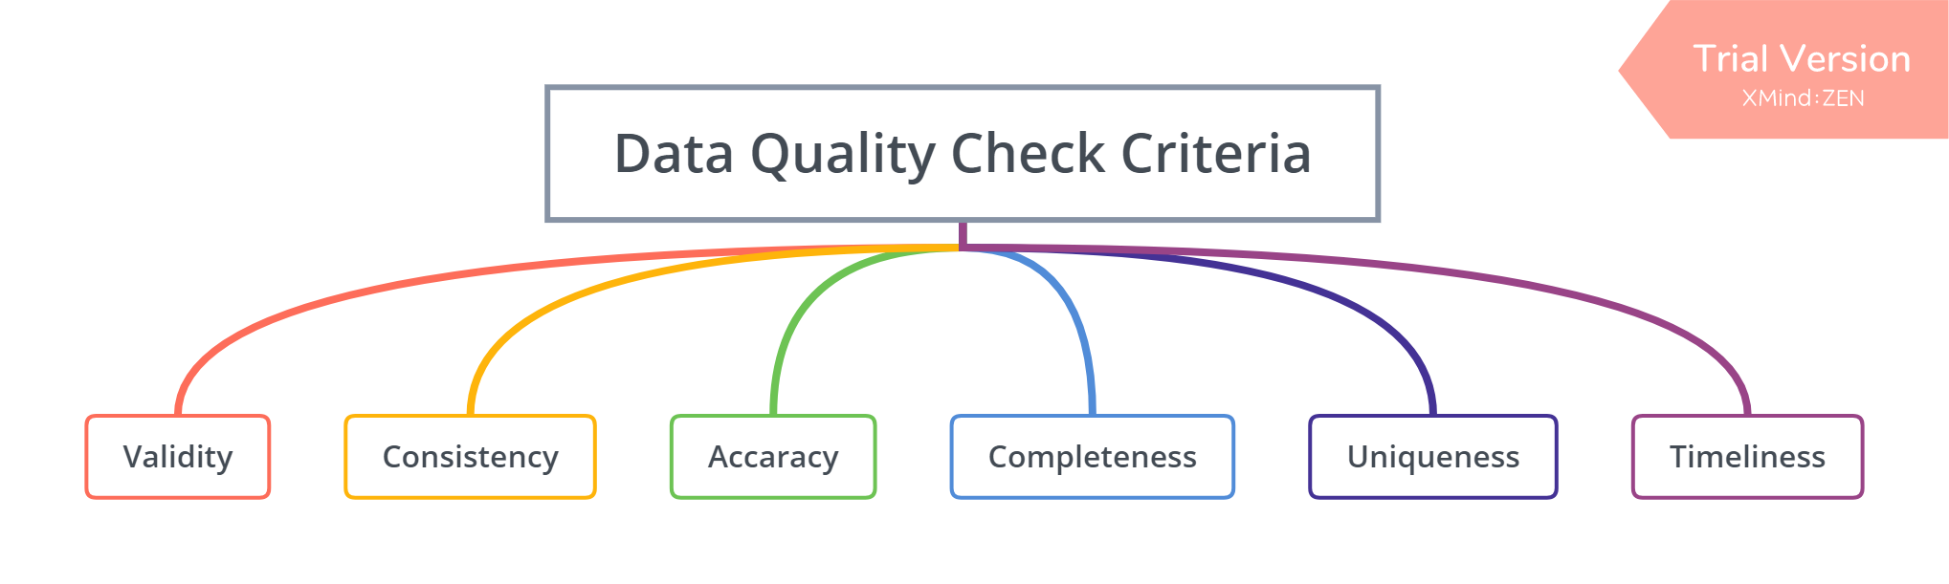

Data Quality Check & Data Engineering
The syntax (format, type, range) conforms to its definition.
The data provided is in accordance with original data source.
The value correctly describes the real world object or event.
Data is complete, no blank values.
No records or features will be duplicated.
The data was collected timely, not delayed.
Notes:
I conducted the data quality check and engineering in python, There are six common criteria for the data quality check. Validity, …..
I assume that the data provided by our client is in accordance with the data in Zillow and Airbnb website, so it meets consistency, and also the data is collected timely and is in accordance with the date. So we only need to check

Slide 8
Data Quality Check & Data Engineering
Validity
Accuracy
Data Types: Correctly reflect the definition (using .dtypes)
Data Values: Only check relevant values for efficiency. The format and range are reasonable(check unique values, and outliers). The zipcode values are unique for each record.
Data Values: The values correctly describe the data (check unique values and descriptive statistics).
Completeness
Uniqueness
Missing Values: There are only missing values for the earlier years (1996-04 ~ 2007-05).
How to fix: Delete the columns for the earlier years and keep the most recent 10 years data.
Duplicates: No duplicated rows or columns(using .duplicated() )
Notes:
For Zillow dataset, for validity, Accuracy and uniqueness, I checked the data types, data values and duplicates, seems they are all right. For the completeness, there are missing values from April 1996 to May 2007. Thinking that the most recent 10 years data are adequate for the analysis, So I deleted the columns of the earlier years.

Slide 9
Data Quality Check & Data Engineering
Validity
Accuracy
Data Types: ‘zipcode’ and ‘price’ has wrong data types because of the special characters like – , $.
How to fix: Using user-defined functions to delete special characters or extract strings.
Data Values: Same process as Zillow. Format and range are reasonable. Detected Outliers(<1%.)
How to fix: Delete outliers.
Data Values: Messy and wrong values in ‘State’ and ‘City’ columns. There are several formats to represent the same state or city.
How to fix: Not use these column to select zipcode. Using USPS provided zipcode list.
Completeness
Missing Values: All the columns with missing values have missing ratio of over 78% (including weekly price and monthly price).
How to fix: Delete the columns. Use daily price as revenue metric.
Uniqueness
Duplicates: No duplicated rows or columns(using .duplicated() )
Notes:
Airbnb has a bad performance in accuracy.

Slide 10
Data Manipulation
Airbnb Dataset
Select zip code in New York City using USPS NYC zipcode list rather than using City or State to choose the zipcode to make sure our selection is accurate.
Select Bedrooms = 2 & RoomType = Entire Home to make sure the property type meet the client’s investment requirement.
Delete irrelevant columns and only keep the columns of zipcode and daily price.
Aggregate by zipcode by using the mean value of daily price.
Zillow Dataset
Select zip code in New York City using USPS NYC zipcode list rather than using City to choose the zipcode to make sure our selection is accurate.
Delete irrelevant columns and only keep the columns of zipcode and property price column of 2007-07 ~ 2017-06.
No aggregation needed for the zipcode because every record has a unique zipcode.
Merging Dataset
Inner join the two datasets on zipcode and finally got 22 zipcodes.
Notes:
After engineering the dataset, I did some data manipulation. I selected records with the right zipcodes and property features and also deleted irrelevant columns. I aggregated the Airbnb dataset by zipcode and finally merged these two datasets.

Slide 11
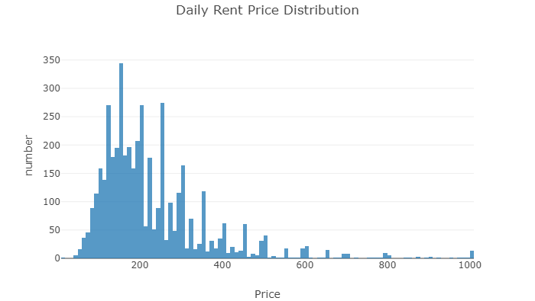
Dataset Visualization
Most: $100 ~ $300
Highest: $1000
100
300
1000
Figure 1 NYC Daily Rent Price distribution
Notes:
These are some visualizations, I will just briefly introduce some of them. I plot a distribution for the daily rent price. Most of them are between 100 and 300 and the highest can be as high as 1000.

Slide 12
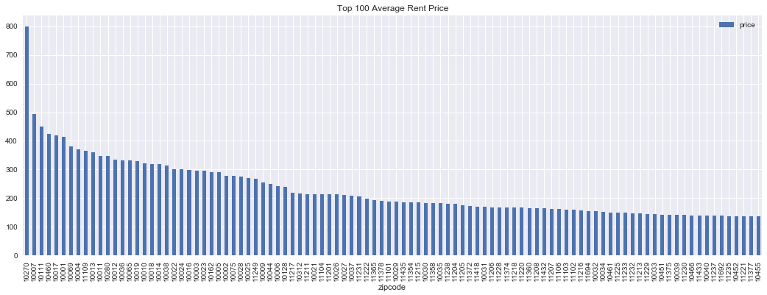
Dataset Visualization
$800
$100
Figure 2 NYC Top 100 Zipcodes with Highest Average Daily Rent Price
1st Highest:
10270 Wall Street
2st Highest:
10007 Tribeca
3st Highest:
10111 Rockefeller Center
Notes:
I also ranked the Top 100 zipcodes with highest average daily rent price. They are all over 100$ which is pretty high, and the highest is 800 dollars. The top three zipcode with the highest average daily rent price are located in Wall Street, Tribeca and Rockefeller Center.

Slide 13
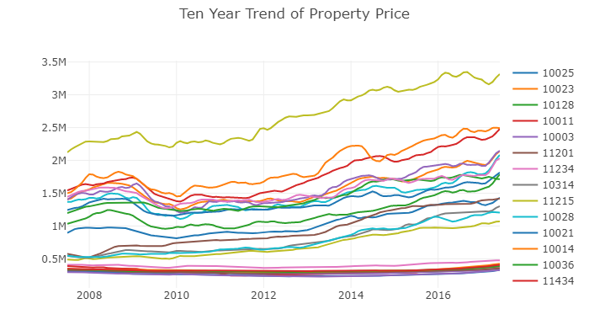
Dataset Visualization
Generally increasing
Higher price increase faster
Decrease in 2010 because the influence of financial crisis
Figure 3 Ten Year Trend of Property Price for all Zipcode
Notes:
This is a plot of the ten years trend of property price. We can see there is an upward trend for the property price so they are generally increasing over the years.

Slide 14
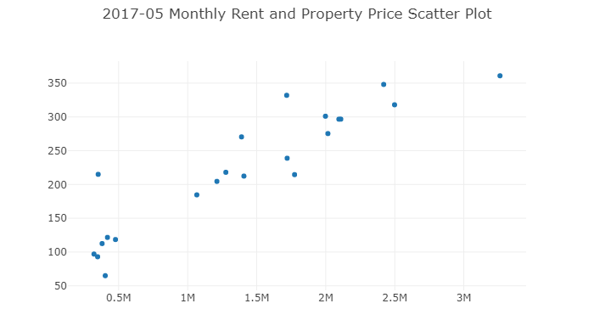
Dataset Visualization
Price
Rent
Figure 4 2017-05 Monthly Rent and Property Price
Notes:
This is a scatter plot for the rent and property price. The have a positive relationship

Slide 15
Model Methodology
Notes:
For the model methodology, I will introduce some assumptions and define the metric to select the zipcode with the best investment worth

Slide 16
Problem Break-down
Measure the profitability and define a metric. According to the metric we can get the top 5 zipcodes to bid for our client’s investment.
Analyze the property price of the target zipcodes in the long-term range to see the potential of the property appreciation within that zipcode area so that we will know the trend of the investment cost.
Analyze the rent price of the target zipcodes and combine with other demographic factors to see the potential of future rent.
Select the zip code with the highest investment worth based on the analysis above.
Notes:
To break down the business problem, firstly I will

Slide 17
Assumptions for Analysis
The other assumptions for the analysis are as follow:
The renting price and property price are in accordance with the date it shows with no delay or mistake.
The rent price in AirBnb is representative in all the renting market and the property price in Zillow is representative in all the house purchasing market in NYC.
The rent price for each property remains same within the month.
The total revenue for the investment mainly comes from the rent, other earnings from the rent process is not counted in this case.
The total cost of the investment mainly comes from the purchasing of the property, other costs and losses will not count in this case.
The days within each month is simplified to 30 days.
The first four assumptions come from the client:
The investor will pay for the property in cash (i.e. no mortgage/interest rate will need to be accounted for).
The time value of money discount rate is 0% (i.e. $1 today is worth the same 100 years from now).
All properties and all square feet within each locale can be assumed to be homogeneous.
The renting occupancy rate in NYC is 75%.
Notes:
These are the assumptions for the analysis.

Slide 18
Define Metric
Rent-to-Price ratio = Total revenue within the month/Total cost
It means the revenue they earned from monthly rent for each dollar they invested in the property. So the higher the ratio, the higher the profitability.
The total revenue within the month is the monthly rent of 2017-05, which is calculated as:
Monthly Rent = Daily Rent*Days within a Month*Occupancy Rate
= Daily Rent*30*0.75
The total cost is the property price of 2017-05.
Therefore, the optimal formula is:
Rent-to-Price ratio = Daily Rent*30*0.75/Property Price
Notes:
The metric I defined is Rent to Price ratio.

Slide 19
Model Results & Insights
Notes:
In this section, I will show the insights of the metric we defined and the insights from the property price and the rent price perspective.

Slide 20
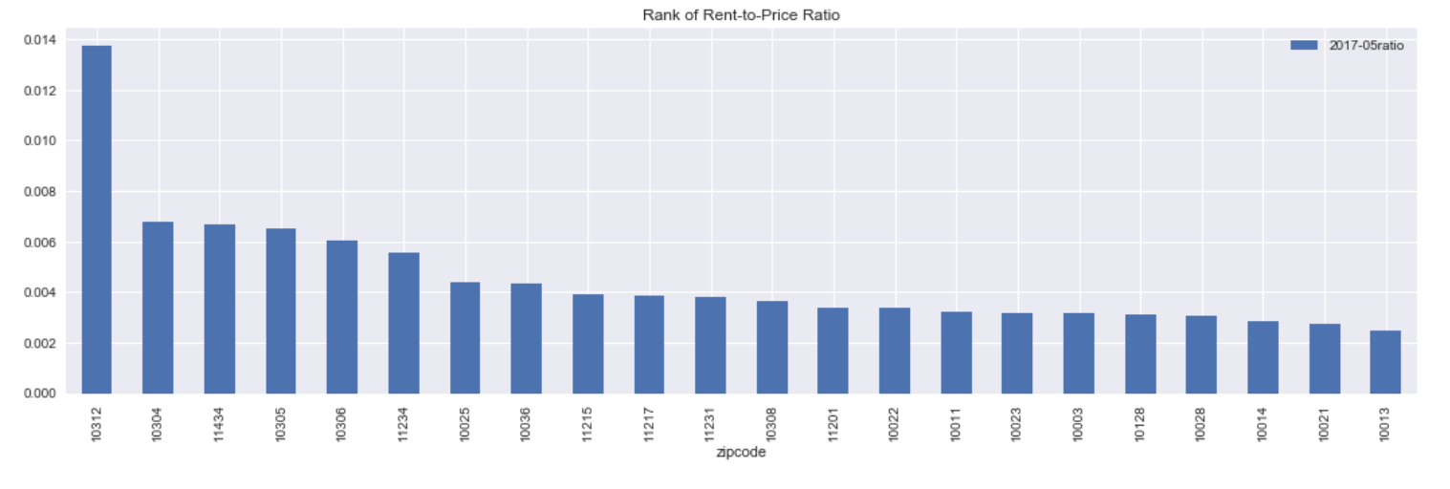
Insight of Rent-to-Price Rate
Figure 5 Rank of Rent-to-Price Ratio
Top 5: 10312, 10304, 11434, 10305, 10306
Notes:
According to the metric, we get the top 5 zipcodes with highest rent-to-price rate. It is … , they will bid for our client investment.

Slide 21
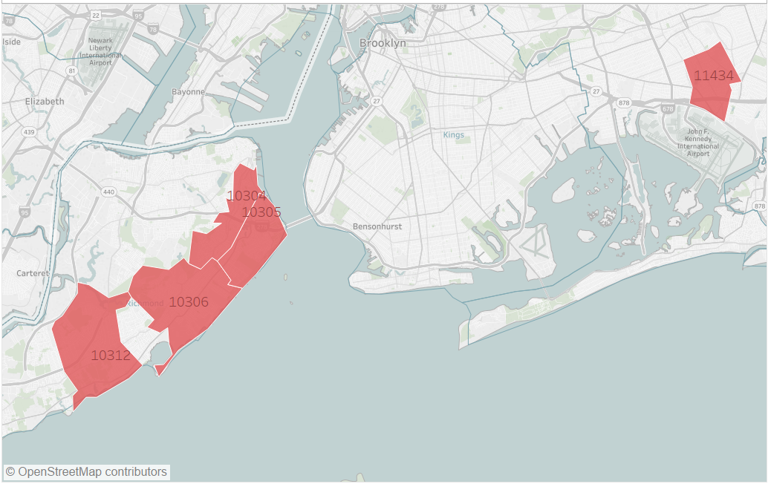
Insight of Rent-to-Price Rate
Brooklyn
11434
Staten Island
10304
10305
10306
10312
Figure 6 Geographic Distribution of the Five Zipcodes
Notes:
If showing them on the map, we can see these five zipcodes are located in Staten Islands and Brooklyn.

Slide 22
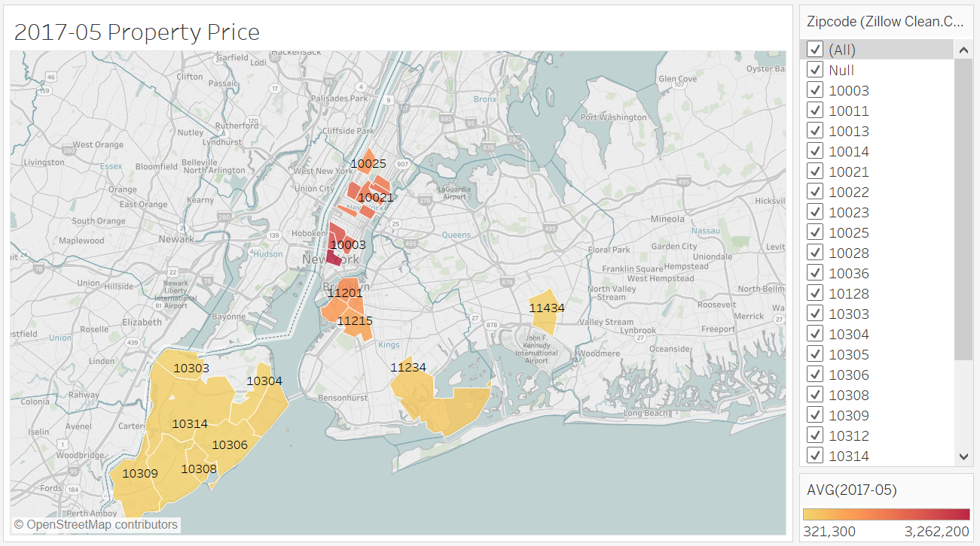
Insights of Property Price
Within Low Property Price Area
Relatively Low Investment Cost
Figure 6 Property Price Level of the Five Zipcodes
Notes:
Now let’s see the insights of Property Price. This figure shows the level of property price. If the color is more to yellow, then it’s low, if it’s more to red, then it’s high. So we can see These five zipcodes are in the area of low property price. So it means relatively low investment cost.

Slide 23
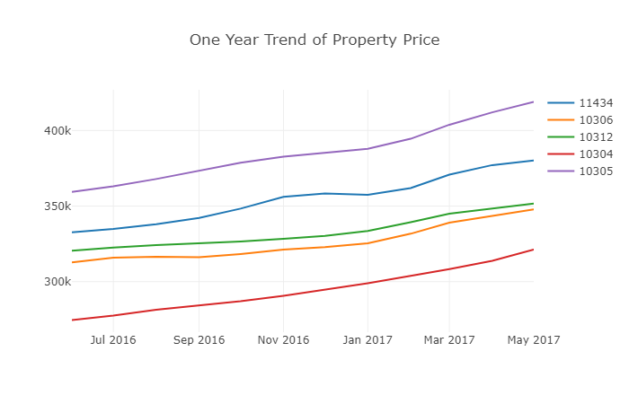
Insights of Property Price
10312: Median
10304: Lowest
Figure 6 One Year Trend of Property Price
Notes:
This figure shows one year trend of the property price. 10312 ranked highest in the rent to price metric, it has a median property price among the five zipcodes. 10304 ranked second highest in rent to price metric, and it has the lowest property price.

Slide 24
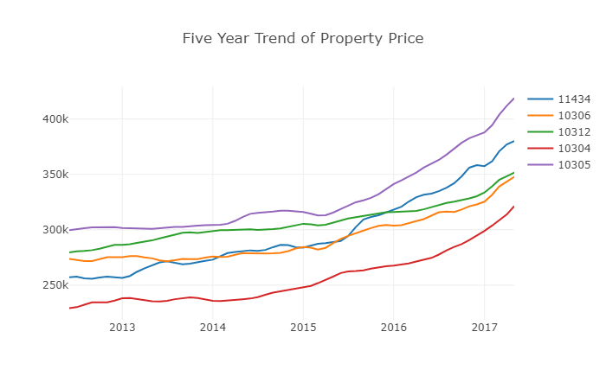
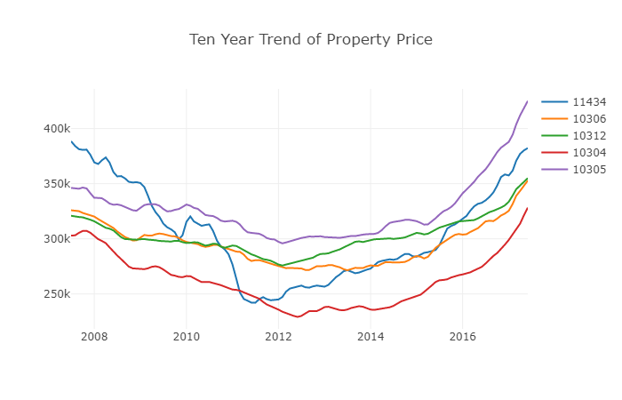
Insights of Property Price
10312: Low Increase Rate
10304: High Increase Rate
10312: Low Investment Cost & Low Increase Rate. Good for investment!
Notes:
For five years trend and ten years trend, 10312 (ranked highest in rent to price ratio) has a relatively low increase rate from the slope among the five. Although10304(ranked second highest) is lowest in property price but it has a high increase rate among the five, so it still has a high potential to have a higher investment cost in the future.

Slide 25
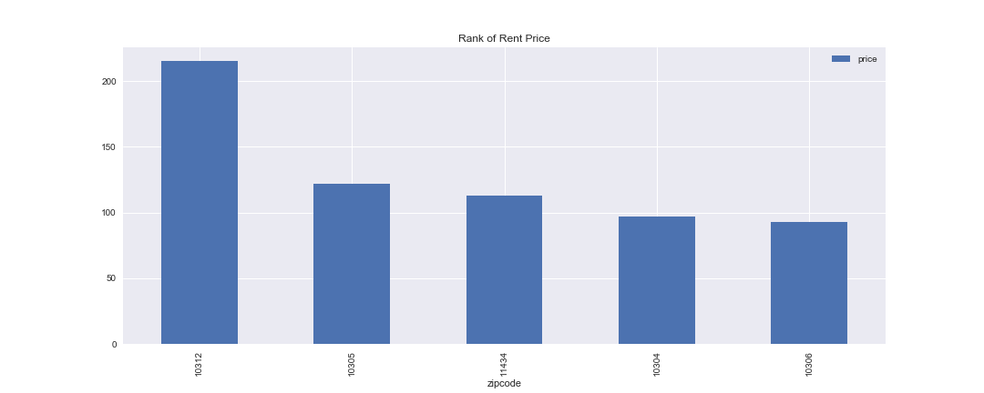
Insights of Monthly Rent
Highest: 10312. Also the only one of the top five in the “NYC top 100 zipcode with highest rent price”
Good for Investment!
Notes:
This is a rank of the rent price for the top five zipcodes. The highest is 10312

Slide 26
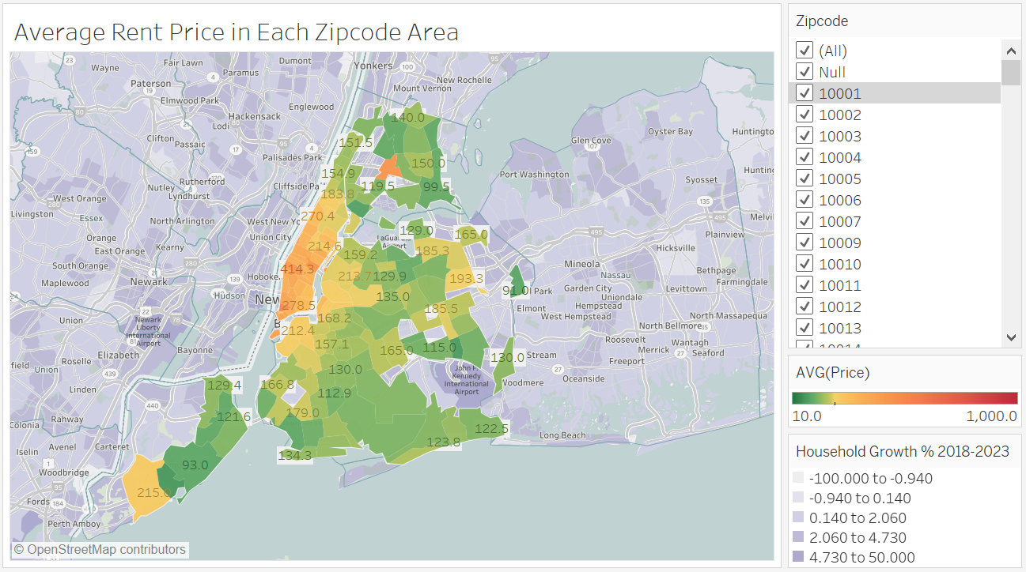
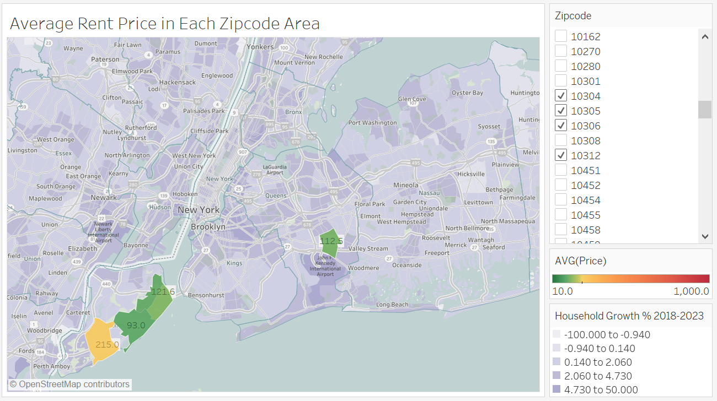
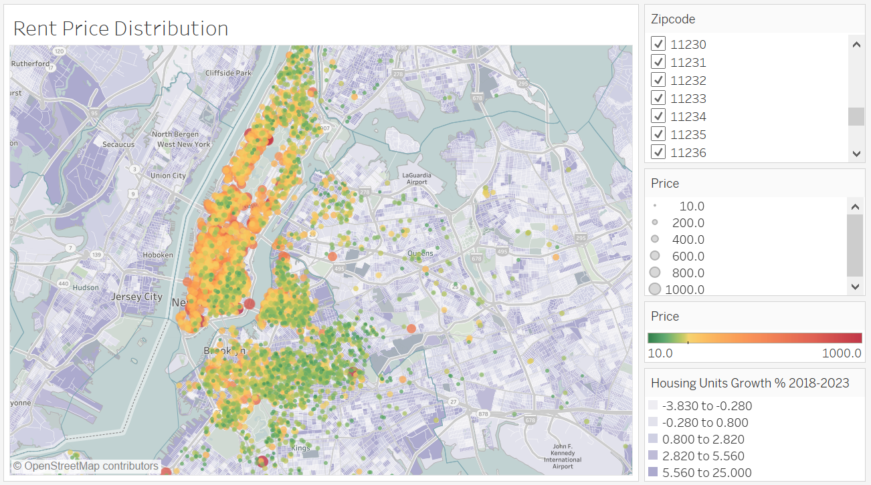
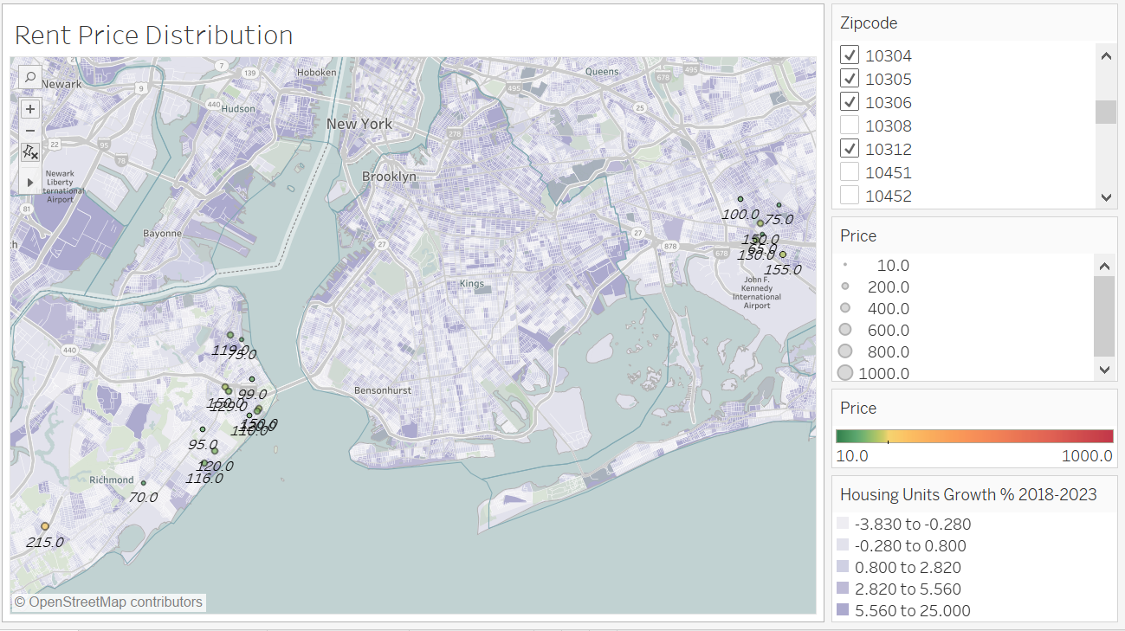
Insights of Monthly Rent
High Rent Price
10312:
High Revenue
& Potential Market Growth.
Good for investment!
10312
Potential Housing Units Growth
10304
10434
10312
Notes:
These four charts shows different levels of monthly rent. If the color is more to red, then it is high, if it’s more to green then it’s low. The purple color on the map shows the housing units growth in the next five years. The two charts on the left are all the zipcodes in NYC. The two charts on the right are the top five zipcode for the rent to price rate. On the upper right figure we can see 10312 has a high rent price because it’s yellow. For the lower right figure, we can see these zipcode are among the areas with potential housing units grouth. So 10312 also shows good potential of

Slide 27
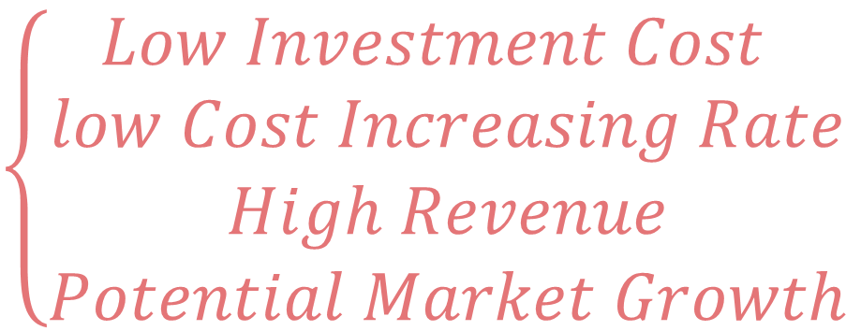
Best Zipcode to Invest
$$\left\{\begin{aligned}Low Investment Cost \\ low Cost Increasing Rate \\ High Revenue \\ Potential Market Growth\end{aligned}\right.$$
10312
Notes:
So we finally picked 10312 because it… So it is good not only for the short term but also for the long term

Slide 28
Further Analysis
Notes:
In order to make our analysis more robust and more comprehensive, we can do further analysis.

Slide 29
Further Analysis
Time Series Analysis for Price-to-Rent Ratio to evaluate an area’s long-term investment potential if having the data of the historical rent price.
Get external economy and social science data and combine with property feature’s data to build machine learning models to investigate the important factors that will affect property price & rent price, so that we are able to better evaluate an area’s overall investment potential.
Competitive Analysis for the investment market.

Slide 30
Appendix
Tableau Public https://public.tableau.com/profile/xinrantao#!/
Main Code
Web Scrapping code
Analysis Report

Slide 31

Thank you

